Slide 1
PROBLEMS SOLVED WITH FLEXBOX
Emily Meroni, Giorgia Baroffio
Chiasso, 11/01/2017

Slide 2

WHO WE ARE
Giorgia
Frontend developer @Appway
Emily
Frontend developer @Appway

Slide 3
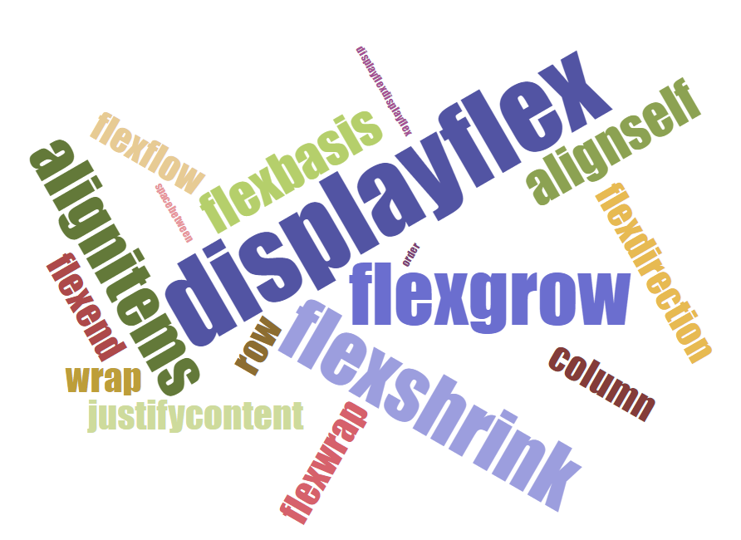
FLEXBOX PROPERTIES

Slide 4
MAIN AXIS and CROSS AXIS
flex-direction: row;
main axis
justify-content → main axis
align-items → cross axis
cross axis
justify-content: center
align-items: flex-start

Slide 5
MAIN AXIS and CROSS AXIS
flex-direction: column;
cross axis
justify-content → main axis
align-items → cross axis
main axis
justify-content: center
align-items: flex-start

Slide 6





BROWSERS SUPPORT
display: flex;
align-items
justify-content
align-content
align-self
flex-basis
flex-shrink
flex-grow
flex
flex-wrap
flex-direction
flex-flow
order
display: -ms-flexbox;
-ms-flex-align (start | end | center | baseline | stretch)
-ms-flex-pack (start | end | center | distribute | justify)
-ms-flex-line-pack
-ms-flex-item-align
-ms-flex-preferred-size
-ms-flex-negative
-ms-flex-positive
-ms-flex
-ms-flex-wrap
-ms-flex-direction
-ms-flex-flow
-ms-flex-order
display: -webkit-flex;
-webkit-align-items
-webkit-justify-content
-webkit-align-content
-webkit-align-self
-webkit-flex-basis
-webkit-flex-shrink
-webkit-flex-grow
-webkit-flex
-webkit-flex-wrap
-webkit-flex-direction
-webkit-flex-flow
-webkit-order
Safari 7
Safari 8
Safari 10

Slide 7
USEFUL RESOURCES
FLEXBOX BUGS https://github.com/philipwalton/flexbugs
CSS TRICKS https://css-tricks.com/snippets/css/a-guide-to-flexbox/
FROGGY http://flexboxfroggy.com/
PERFORMANCE https://developers.google.com/web/fundamentals/performance/rendering/avoid-large-complex-layouts-and-layout-thrashing#use_flexbox_over_older_layout_models

Slide 8
Q&A?

Slide 9
THANK YOU!

